Slide 1
Usability Engineering
I am trying to update my examples in my intro to HCI class which starts in Mini 2. Does anyone have any /new/ examples where bad UIs causes /disasters/. I am using the usual suspects:
Telephony outage due to typo:
https://www.bleepingcomputer.com/news/software/software-bug-behind-biggest-telephony-outage-in-us-history/
https://www.washingtonpost.com/news/morning-mix/wp/2018/01/16/that-was-no-wrong-button-in-hawaii-take-a-look/?utm_term=.2b377ece20f8
·Ford dropped in ratings in 2011 due to touch screen interface
ohttp://www.cooper.com/journal/2011/07/will_ford_learn.html
·Ford is recalling about 13,500 2015 Lincoln MKC because drivers are shutting the vehicle off by mistake.
ohttp://money.cnn.com/2015/01/06/autos/ford-push-button-ignition-recall/index.html
·Nokia and RIM losing phone business
ohttp://en.wikipedia.org/wiki/File:World_Wide_Smartphone_Sales_Share.png
·Aegis
oJuly 4, 1988; Iranian Airbus shootdown by the /Vincennes/
ohttp://www.washingtonpost.com/wp-srv/inatl/longterm/flight801/stories/july88crash.htm
http://en.wikipedia.org/wiki/USS_Vincennes_%28CG-49%29
·Deaths in kids:
http://pediatrics.aappublications.org/cgi/content/abstract/116/6/1506
o“Unexpected Increased Mortality After Implementation of a Commercially
Sold Computerized Physician Order Entry (CPOE) System”
oBecause it took so much longer, did /not/ reduce errors overall
·Florida ballots (2000)
ohttp://www.asktog.com/columns/042ButterflyBallot.htm
<http://www.asktog.com/columns/042ButterflyBallot.html>
Toyota's "sticky accelerator" problem was arguably a UI problem. http://abcnews.go.com/Blotter/toyota-pay-12b-hiding-deadly-unintended-acceleration/story?id=22972214
Also, the USS Vincennes: https://www.scientificamerican.com/article/pogue-5-of-the-worst-user-interface-disasters/
Programming Usable Interfaces (PUI)
05-430/05-630 Fall 2018
Jason Hong
jasonh@cs.cmu.edu
Notes:
Video to load
https://www.youtube.com/watch?v=3ResTHKVxf4

Slide 2
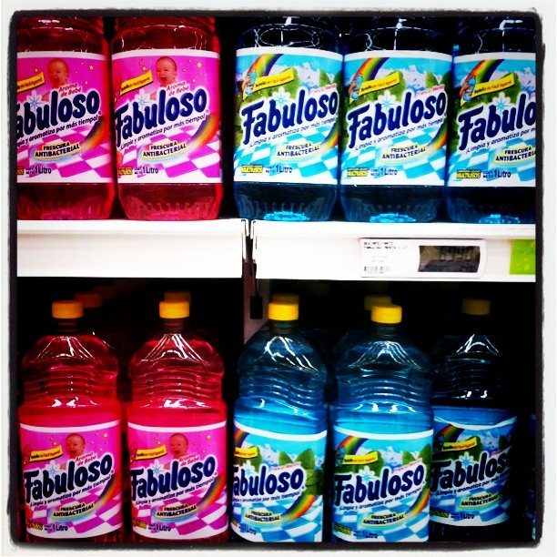
Notes:
http://digg.com/2016/flawed-design-deadly-results-propublica

Slide 3
Examples of Design Errors
The colorfully packaged multi-purpose cleaner Fabuloso has a record of mistaken identity. In 2006 researchers looked at about four months of data from the Texas Poison Center Network and found 94 cases of people accidentally ingesting the household cleaner.
http://digg.com/2016/flawed-design-deadly-results-propublica

Slide 4
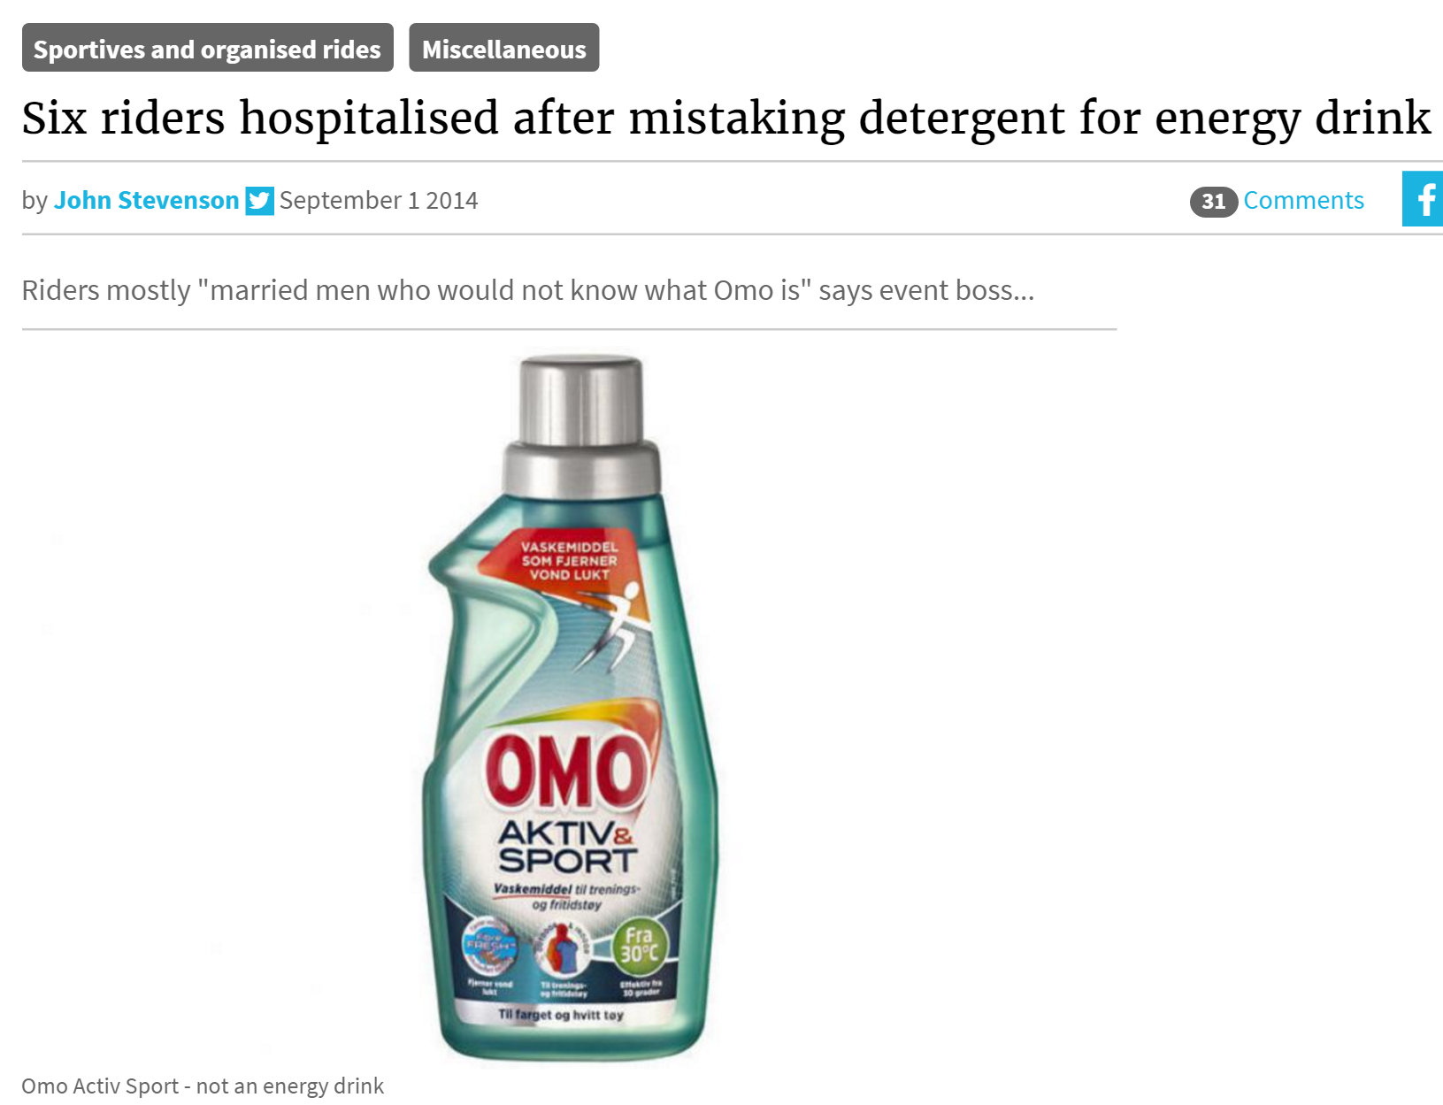
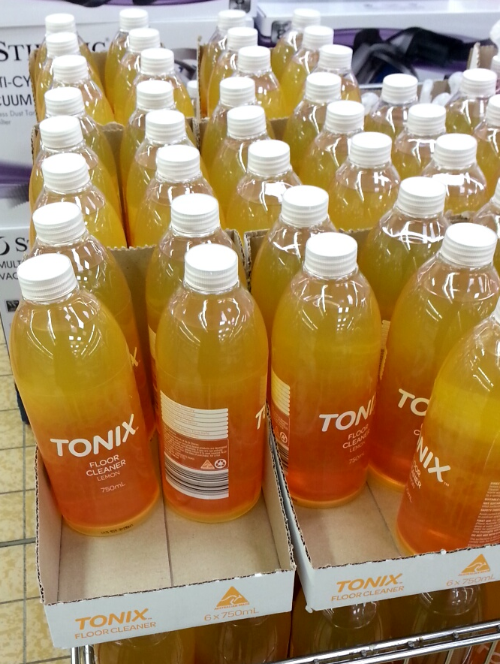
Examples of Design Errors

Slide 5
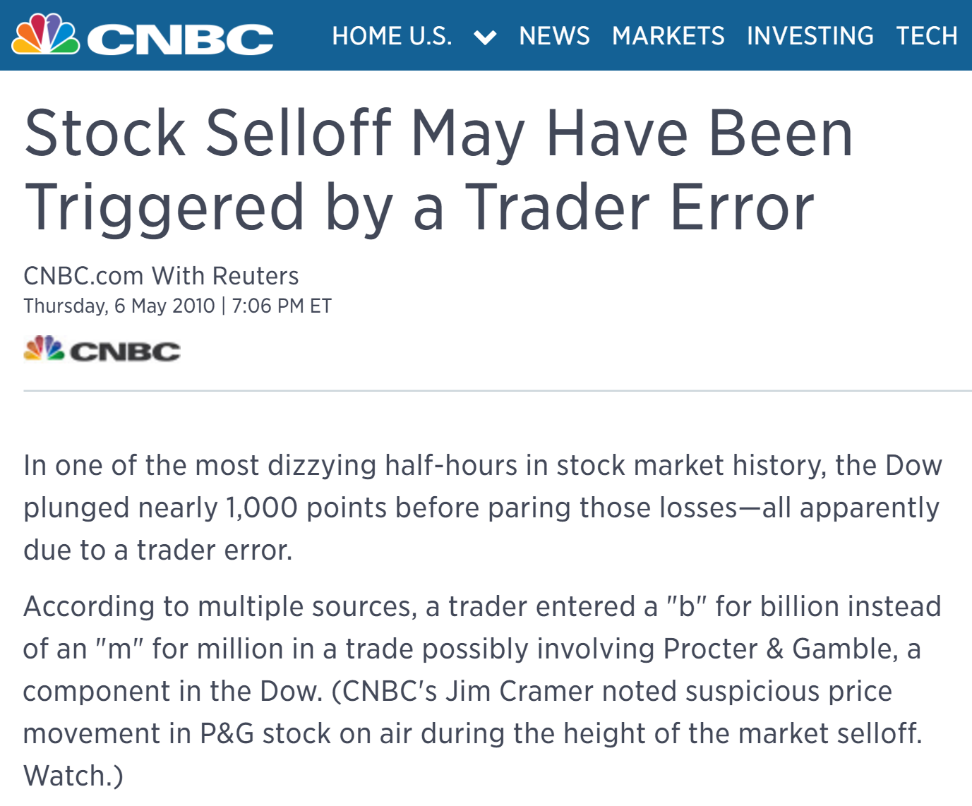
Examples of Design Errors

Slide 6
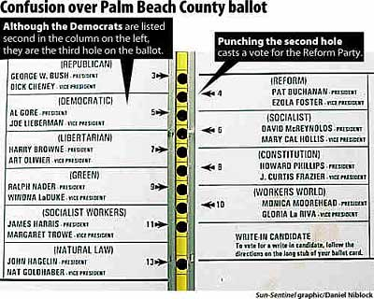
Florida Ballots (2000)

Slide 7


What Happened to 18,000 Votes? Results of the Sarasota Source Code Audit
Michael I. Shamos, Ph.D., J.D.
Institute for Software Research
School of Computer Science
Carnegie Mellon University

Slide 8
Florida U.S. House District 13
Vern Buchanan (R) beat Christine Jennings (D) by 369 votes of 238,249 cast, a 0.15% margin
In Sarasota County, 18,412 ballots showed no vote at all in that race, an undervote of 15%
The other counties in District 13 had an average undervote of 2.5% (range: 2.1-4.0%)
Jennings beat Buchanan 65,487-58,632 in Sarasota County
If the 18,412 undervotes had same percentage (52.76%-47.24%), Jennings would win by 648 votes

Slide 9
Some Possible Explanations
Software error?
Voters cast votes, but no votes were recorded
Unlikely, because 85% of votes were counted
Did post-election testing, source code review
Tampering (malicious software)?
Post-election testing + source code review
Conscious voter protest?
Unlikely, because of comparison demographics
Ex. Absentee (opscan) undervote in Sarasota was 2.6%
Bad ballot layout – voters missed the race
Compare with Charlotte County
Look for Buchanon/Jennings House District 13 race in the following screen shots and remember which page you saw it on

Slide 10
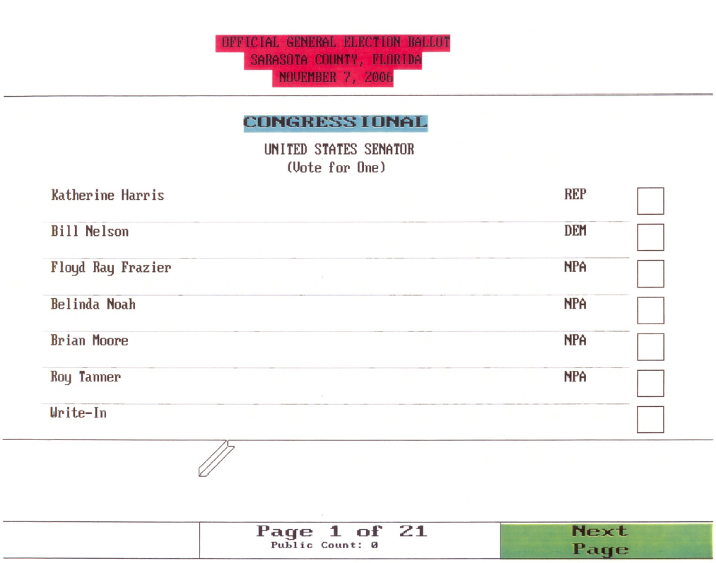
The Sarasota Ballot

Slide 11
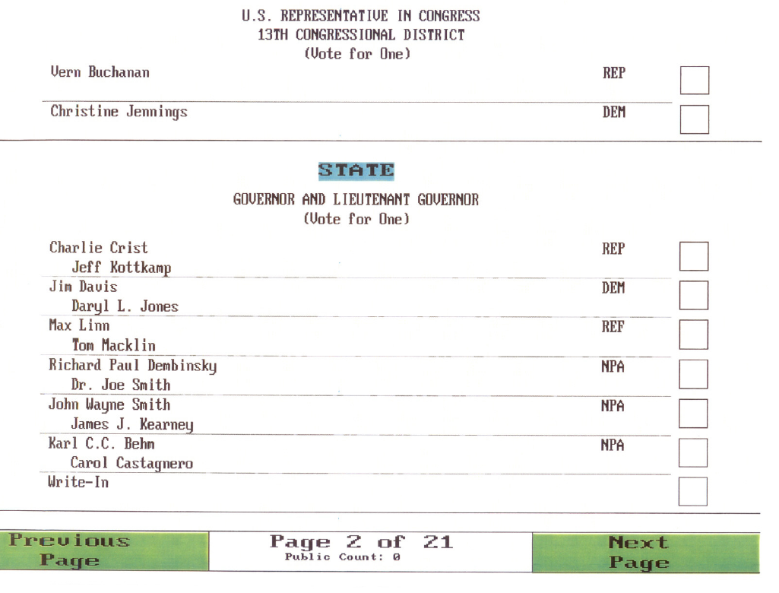
The Sarasota Ballot

Slide 12
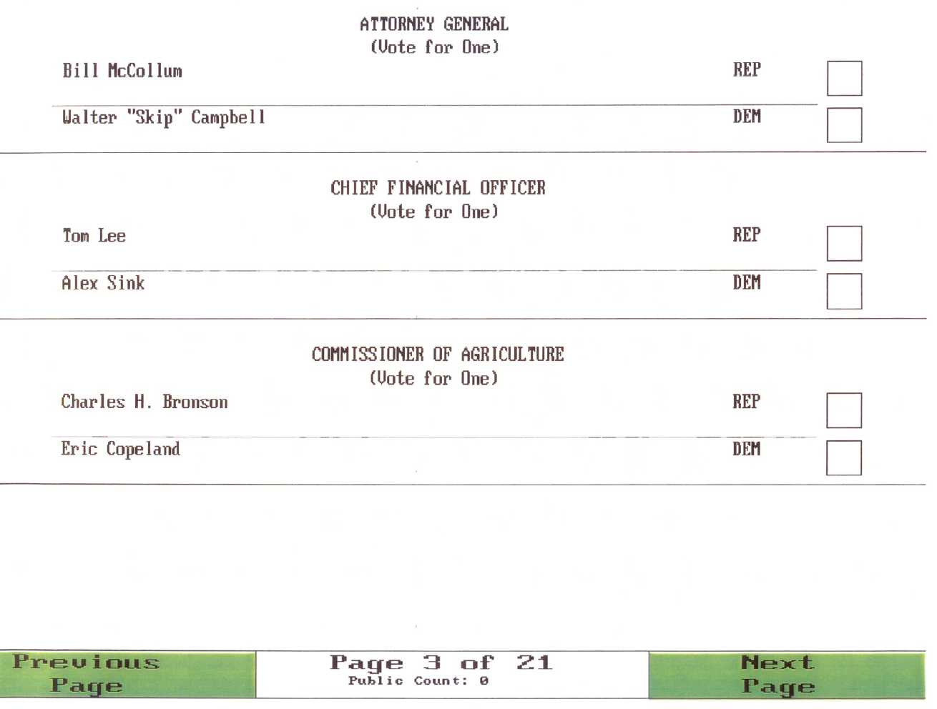
The Sarasota Ballot

Slide 13
Results of Undervote per Screen

Slide 14
The Sarasota Ballot
UNDERVOTE 1.1%

Slide 15
The Sarasota Ballot
UNDERVOTE 15%
UNDERVOTE 1.3%

Slide 16
Recap of Whys and Hows of Prototyping
Low- vs Medium- vs High-Fidelity
Pros and Cons of Low-Fidelity Paper Prototyping
Wizard of Oz testing
Connecting UX with Lean Startup / Agile
Other kinds of prototyping
Bodystorming
Video prototypes
Running user studies

Slide 17
Today’s Outline
We’ve focused so far a lot on creative aspects of design and rapid prototyping
Now, we’ll look at ways of designing and evaluating to minimize design bugs
Types of errors
Designing for errors
Common Usability Bugs / Heuristic Evaluation
Note 1: if you previously took UCRE, some overlap with HEval (now moved into PUI)
Note 2: lots of design bugs out there, will only address a few common ones in class today

Slide 18
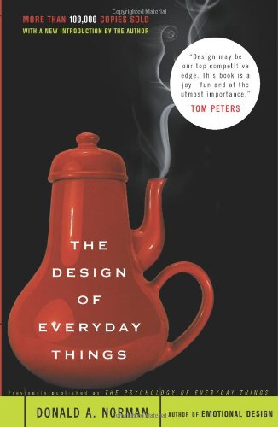
Kinds of Errors
Slips
Very common kind of error
Typos, hitting the wrong menu item
Automatic behaviors
Right goal, wrong action
Mistakes
Conscious deliberation
Wrong goal

Slide 19
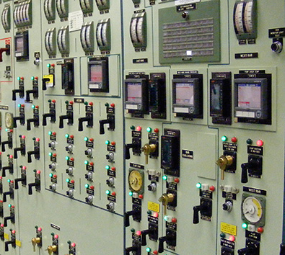
Slips
Capture errors
Frequently done activity takes over
Description errors
Ex. Flipping wrong switch
Data-driven errors
Ex. Call secretary to reserve room, dial room number
Associative activation
Ex. Office phone rings, but say “come in”
Loss of activation
Go into room and forget why

Slide 20
Mode Errors
Mode errors are a particularly interesting (and dangerous) kind of slip error
Modes: “a state of the user interface that lasts for a period of time, is not associated with any particular object, and has no role other than to place an interpretation on operator input”
More intuitively: same input, but different outputs depending on mode
Notes:
Sadly, this design for Jeep led to Anton Yelchin’s death
Mode error

Slide 21
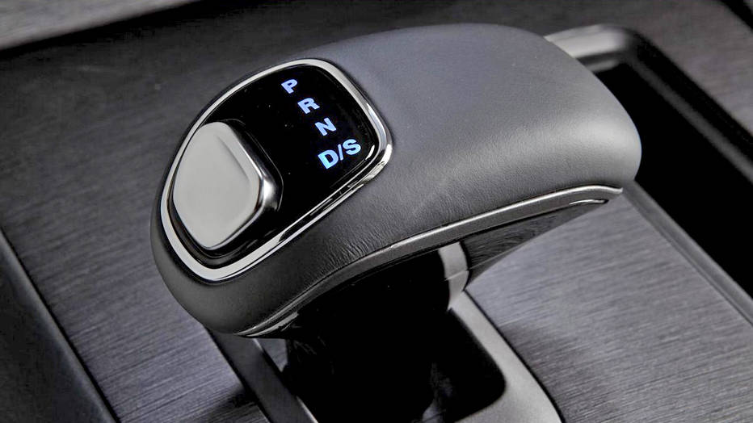
Example Mode Errors
Notes:
Sadly, this design for Jeep led to Anton Yelchin’s death
Mode error
This design lacks visibility, it’s a relative shift vs an absolute one like the one on the next screen

Slide 22
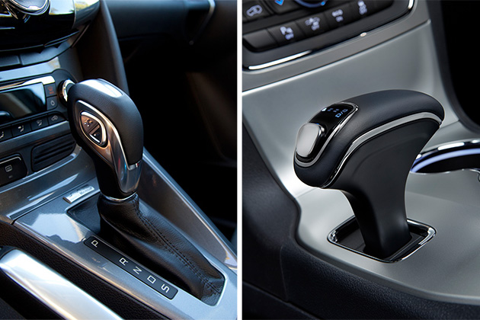
Example Mode Errors
Mode errors
Notes:
Sadly, this design for Jeep led to Anton Yelchin’s death
Mode error

Slide 23
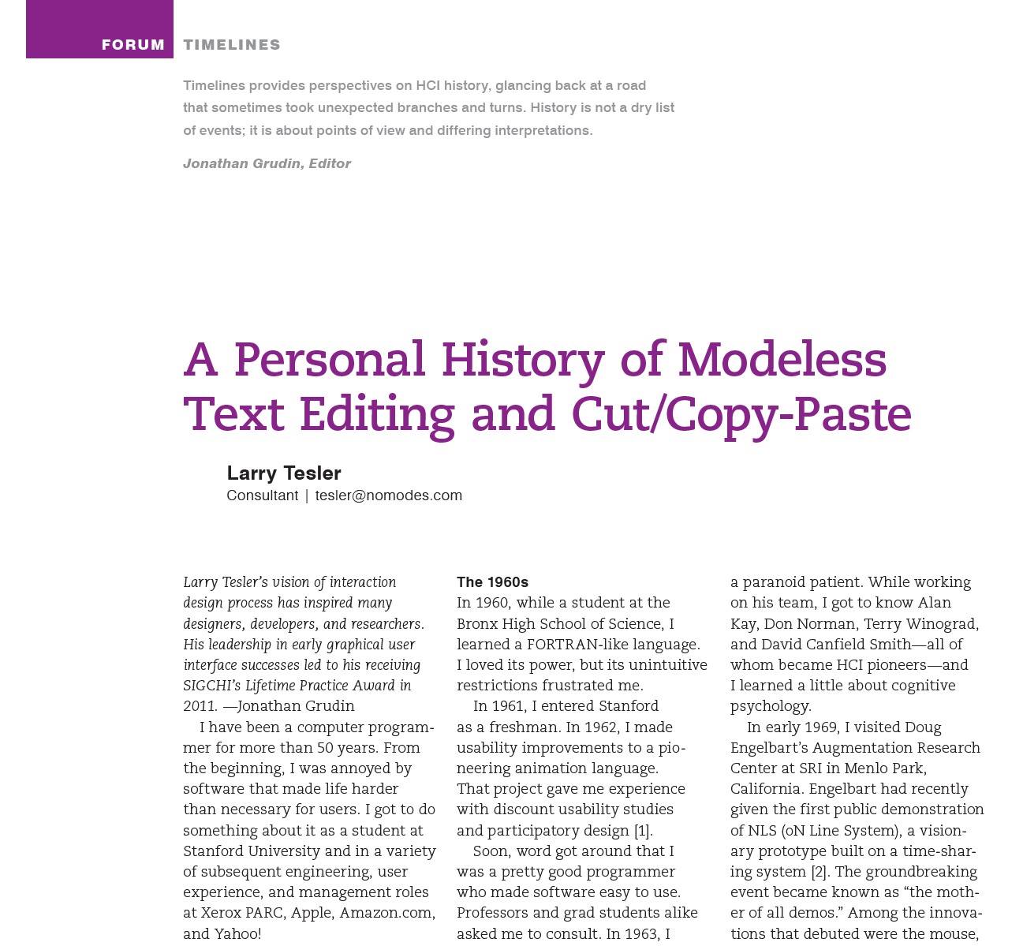
A History Lesson on Modes
Design of modeless cut/copy-and-paste
Also good case study of iterative design + theory
Notes:
A personal history of modeless text editing and cut/copy-paste
http://dl.acm.org/citation.cfm?doid=2212877.2212896

Slide 24
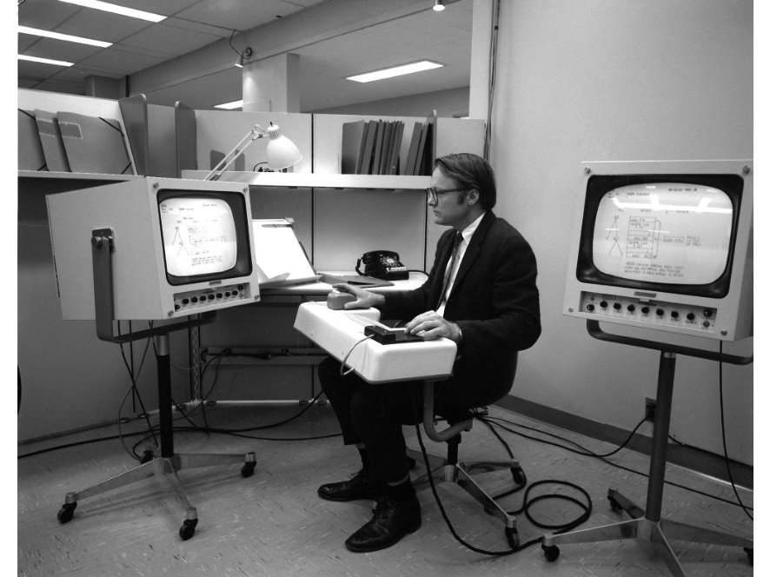
NLS
Notes:
A personal history of modeless text editing and cut/copy-paste
http://dl.acm.org/citation.cfm?doid=2212877.2212896

Slide 25
Text Editing in NLS
D(elete) W(ord) <mark affected word> <ok>
M(ove) T(ext) <mark source text start> <mark source text end><mark destination> <ok>
I(nsert) S(tatement) <mark destination> <type text to insert> <ok>
Your thoughts about this approach?

Slide 26
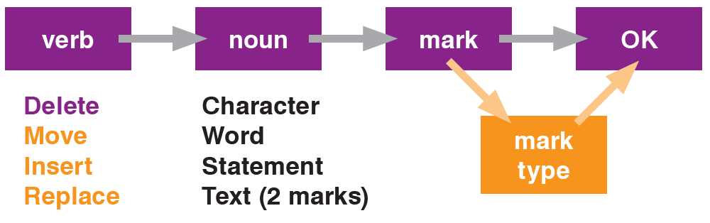
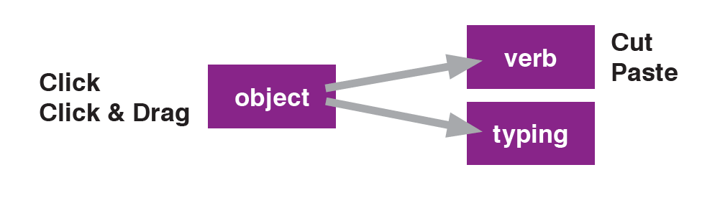
Modal Text Editing vs Modeless
Modal (with modes)
Modeless

Slide 27
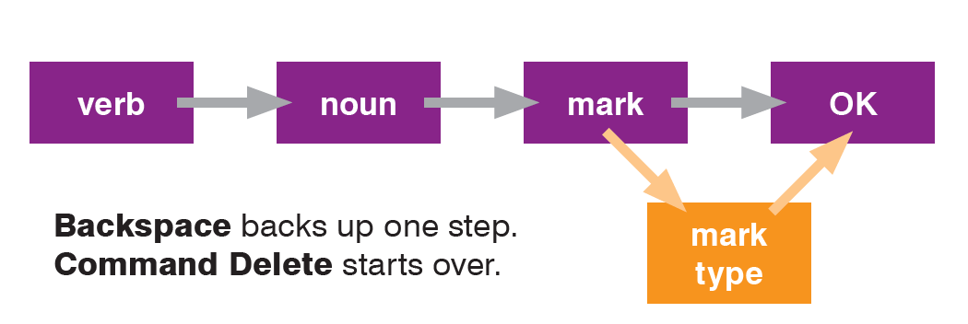
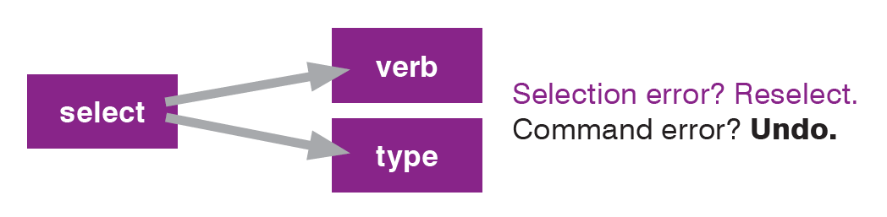
Modal Error Recovery vs Modeless
Modal (with modes)
Modeless

Slide 28
Downsides of Modes
Verbs precede their objects
With noun-verb, object already specified and can execute command immediately
User has to keep track of mode changes
Ex. Might accidentally enter multiple commands if person thinks they are in text mode
Mode escape isn’t always clear
How to switch between modes or cancel mode

Slide 29
Another Famous Mode Error
Airbus A320 crash in 1992
Attributed to mode error
“Flight 148 crashed because the pilots inadvertently left the autopilot set in Vertical Speed mode (instead of Flight Path Angle mode) then entered "33" for "3.3° descent angle", which for the autopilot meant a descent rate of 3,300 feet (1,000 m) per minute.”
Notes:
https://en.wikipedia.org/wiki/Air_Inter_Flight_148

Slide 30
Quick Quiz (not graded) Are these a mode error? True/false
Caps lock on/off when typing in password
Using a paint tool, drawing a Lasso when wanted a Rectangle
Trying to make a phone call when in airplane mode

Slide 31
Approaches to Designing for Slips? Your Thoughts?
Capture errors
Frequently done activity takes over
Description errors
Ex. Flipping wrong switch
Data-driven errors
Ex. Call secretary to reserve room, dial room number
Associative activation
Ex. Office phone rings, but say “come in”
Loss of activation
Go into room and forget
Mode errors

Slide 32
Approaches to Designing for Slips?
Clear slide each semester

Slide 33
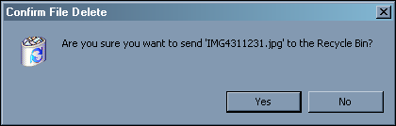
Designing for Slips
Confirmations don’t help (much)
Confirms operation more than parameters
Habituation, react to by rote

Slide 34
Designing for Slips
Two general strategies
Prevent errors
Improve detection and responses

Slide 35
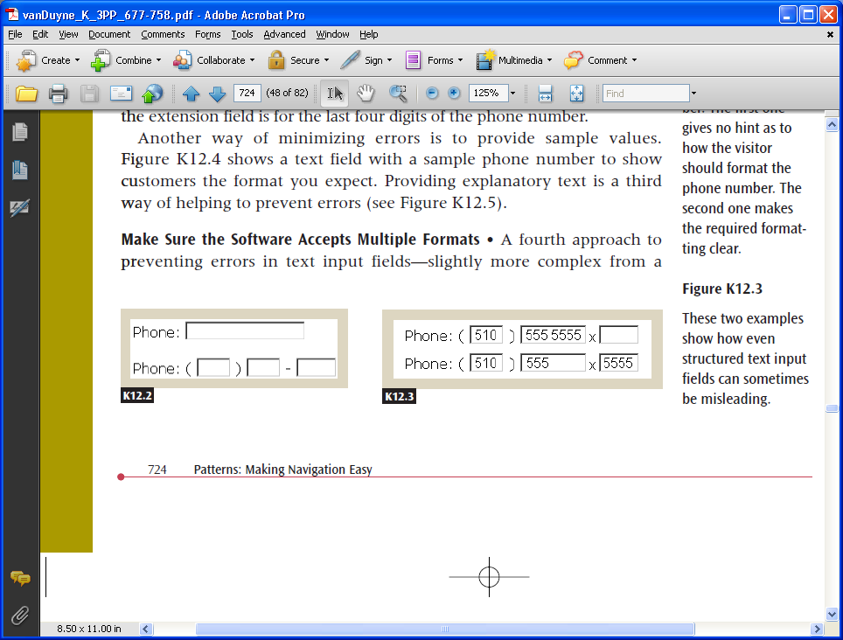
Preventing Errors

Slide 36
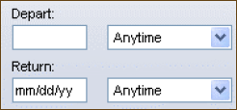
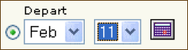
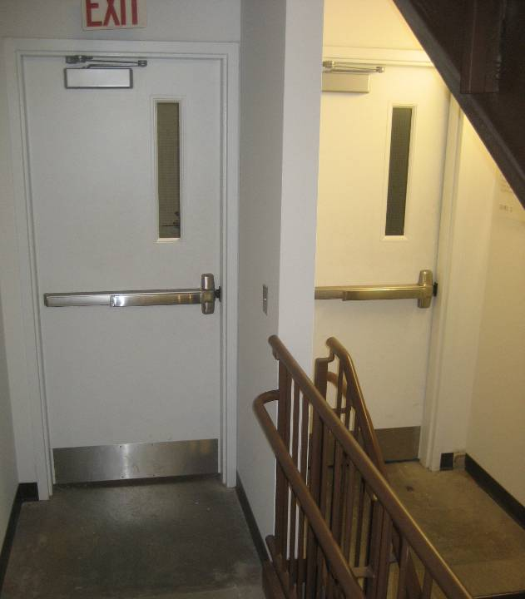
Preventing Errors
Selection rather than fill-in
Prevents wrong formats
“Forcing functions”
Ex. Physical constraints
Purpose of this?
Ex. Have car key to lock
Basically, make it hard to do important actions
Notes:
Bottom picture is in Gates Hillman

Slide 37
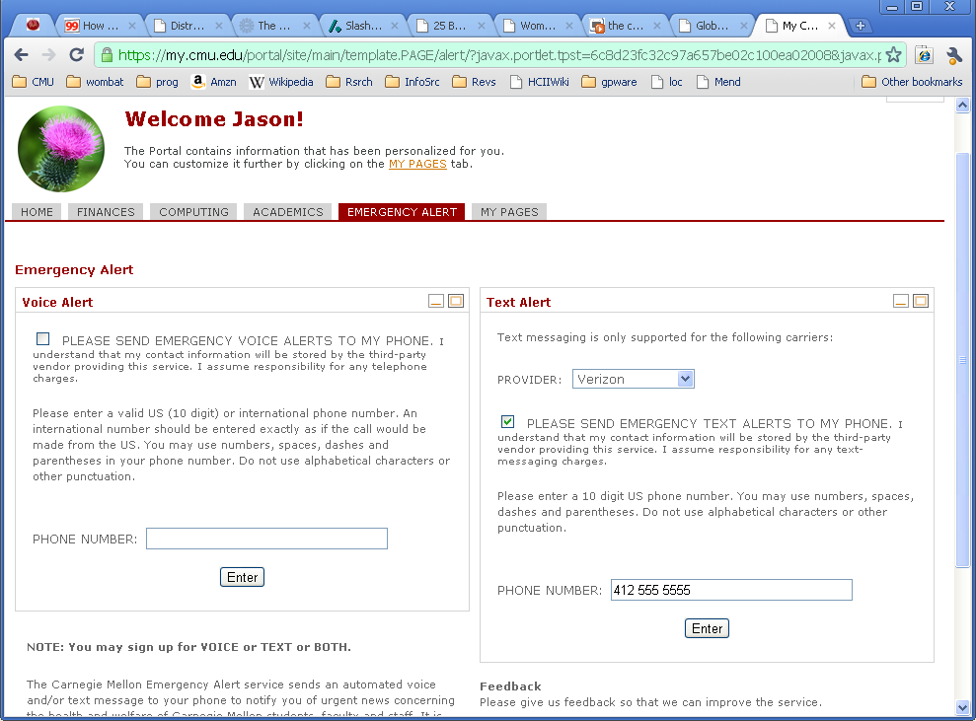
Notes:
Just focus on the right side
Enter in a phone number, hit Enter

Slide 38
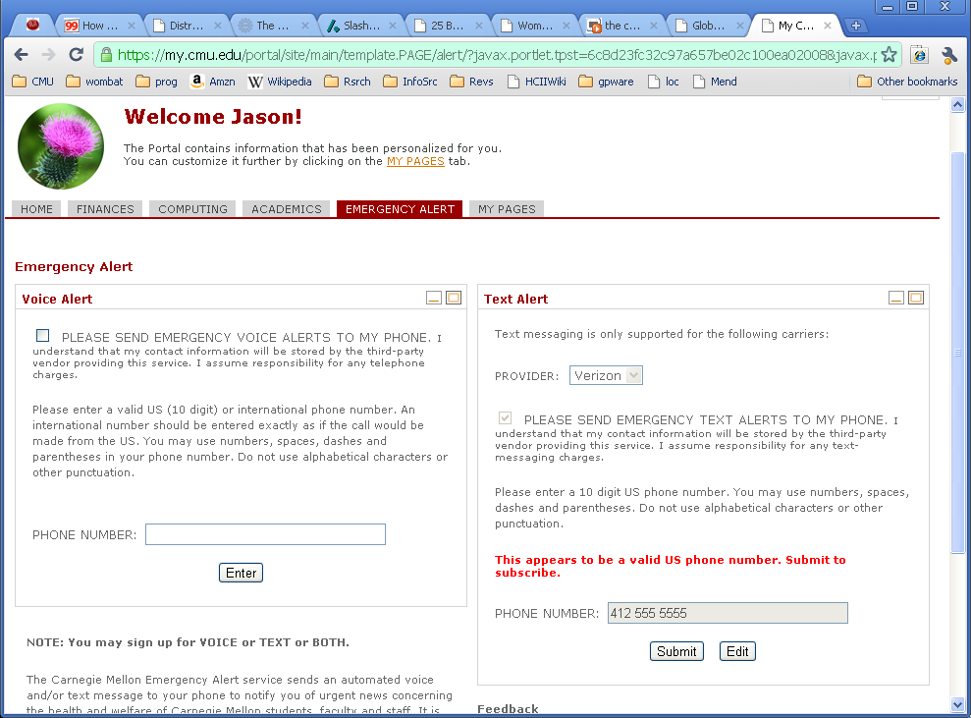
Notes:
And then you see this screen. What happens now?
I didn’t realize it at the time, but I thought I had finished the task. It turns out that entering your phone number only checks if the number is valid, it doesn’t actually add the phone number to the text alert list.
This is a broken task flow. It can do an add and submit at the same time, rather than breaking it up into two separate steps.

Slide 39
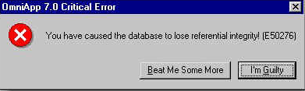
Detecting and Responding to Errors
Reduce severity of errors
Cancel and undo
Make errors more obvious
Good feedback
Uncaught or misunderstood errors tend to quickly lead to malformed mental models

Slide 40
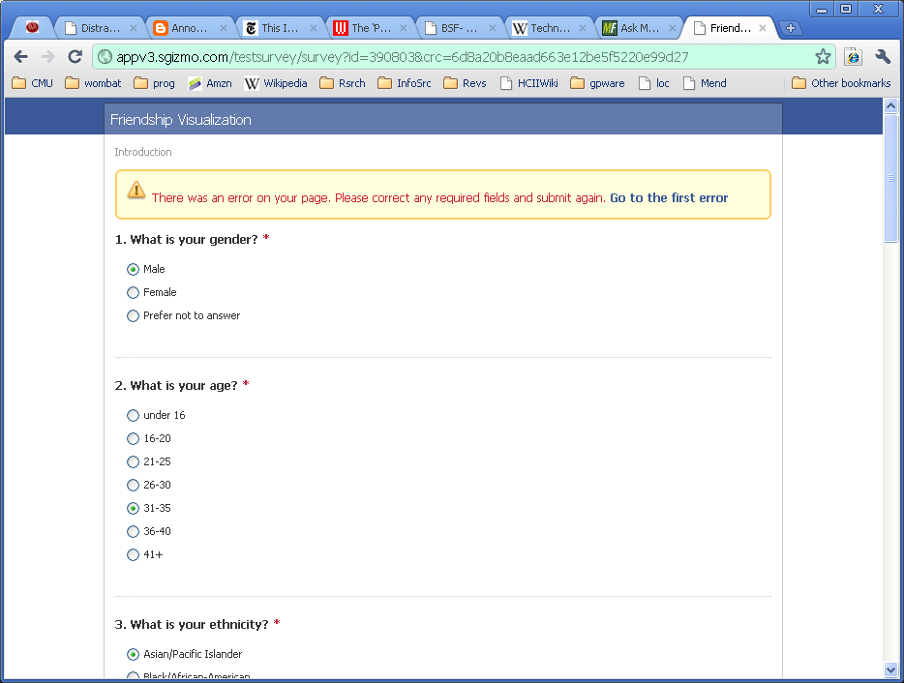
Notes:
Pretty good example, since the page changes pretty dramatically with the error message, and it has a link to go to the first error

Slide 41
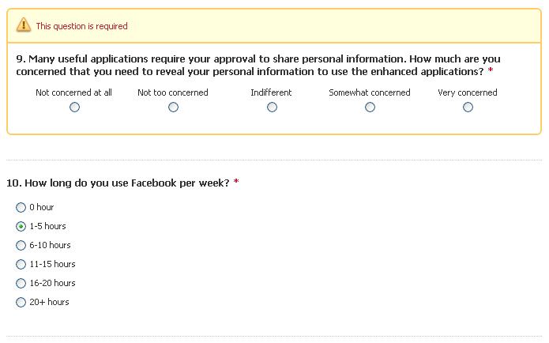

Slide 42
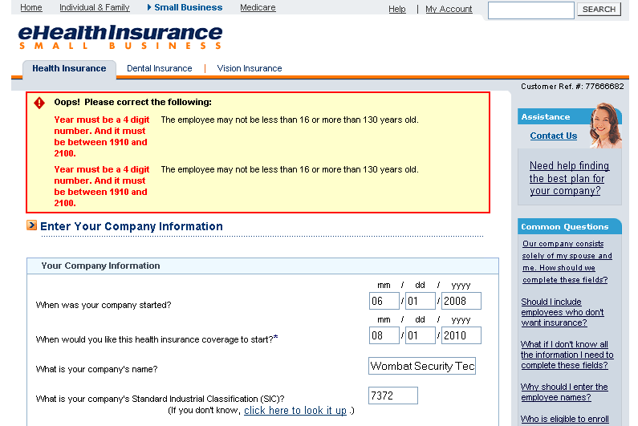
Notes:
Pretty good error message, but doesn’t make clear where the error is, especially if there are multiple dates in the form.
So a user would have to go back and forth between error message and the form to figure out where the problem is.

Slide 43
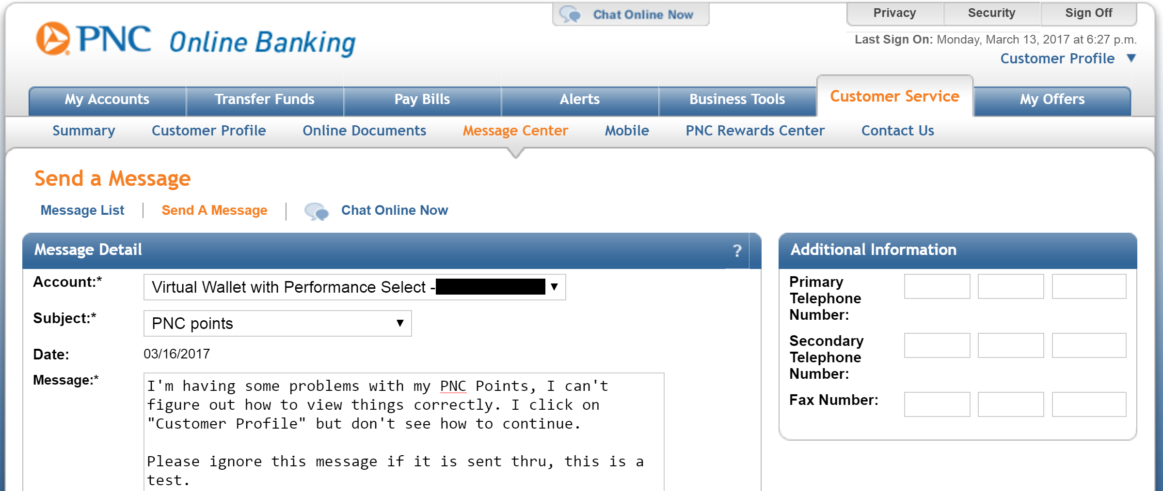
An Odd Error
Notes:
Here’s an actual error I encountered. I was having problems with my bank (PNC) and wanted to send a message to them.

Slide 44
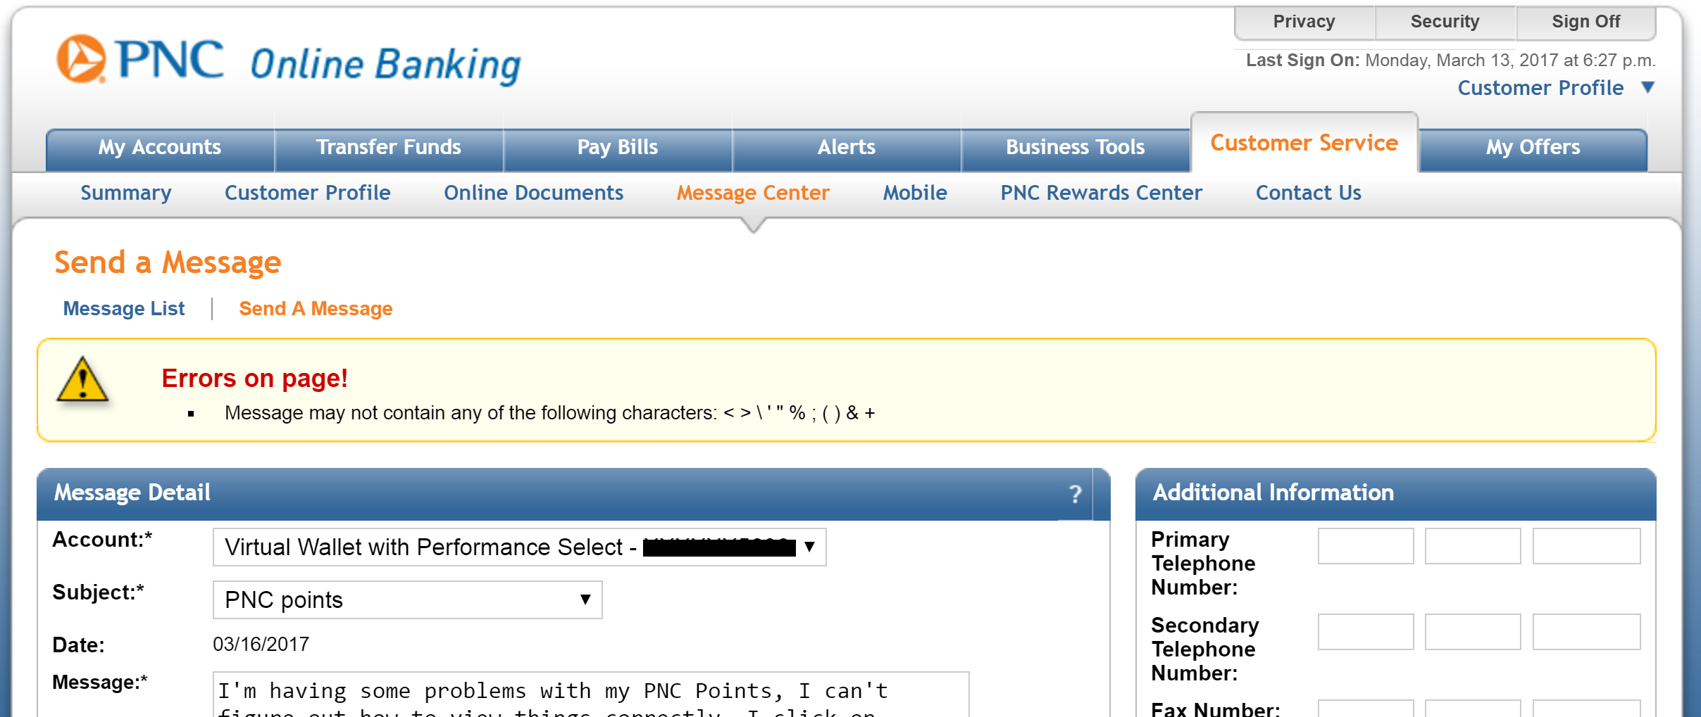
An Odd Error
Notes:
Here’s the error message I got. What’s the problem?
It turns out that you can’t use apostrophes (!), which also means you can’t use contractions in the text (!!)
This is an example of an error message (and a problem) that shouldn’t exist.
It’s probably for security reasons, but the simpler solution is to escape the text to prevent SQL injection attacks as well as XSS attacks.

Slide 45
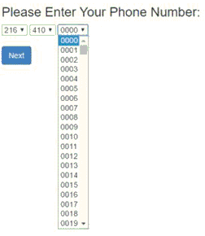
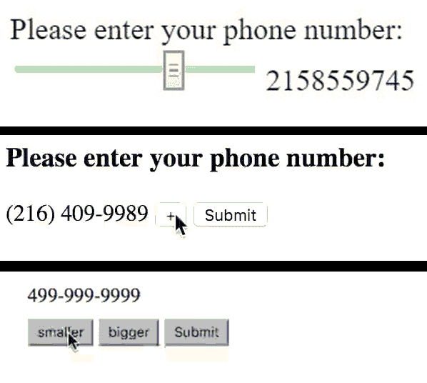
Contest: Worst UIs possible
Notes:
Aside: bad user interface contest

Slide 46
Administrivia
HW2A / HW2B due Wed Jan 31 at 11:59pm
Should have done an iteration at this point
Did some user testing with another student in class
Next reading
None
Design of Everyday Things
Get book and start reading it
Reminder: do tutorials on HTML / CSS
Will start class portion in two weeks
Update
Add HW2a check about other student

Slide 47
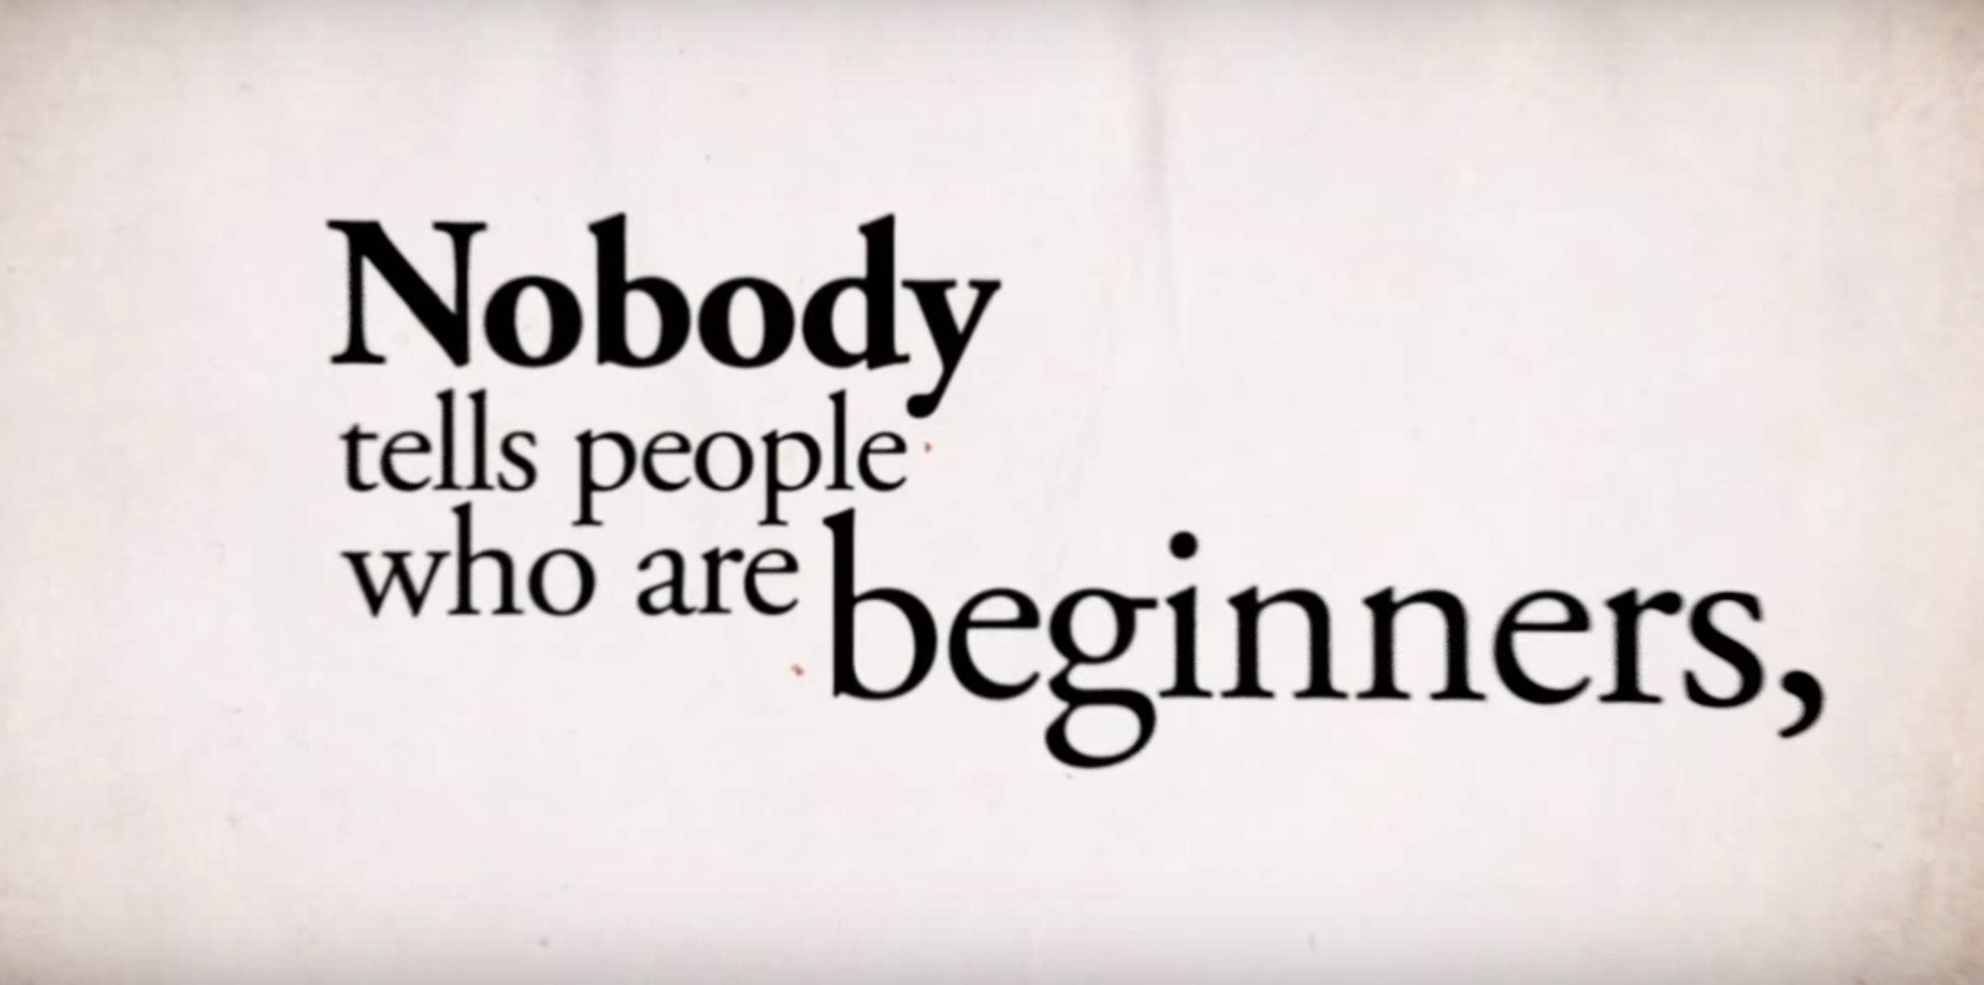
Ira Glass on Creativity
https://www.youtube.com/watch?v=3ResTHKVxf4

Slide 48

Today’s Outline
Types of errors
Designing for errors
Common Usability Bugs / Heuristic Evaluation
Over next few slides, will show GUI screenshots
You point out usability bugs
And suggest a fix
Some examples from this book

Slide 49
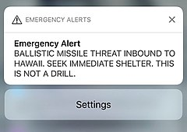
Hawaii Jan2018 Missile Alert

Slide 50
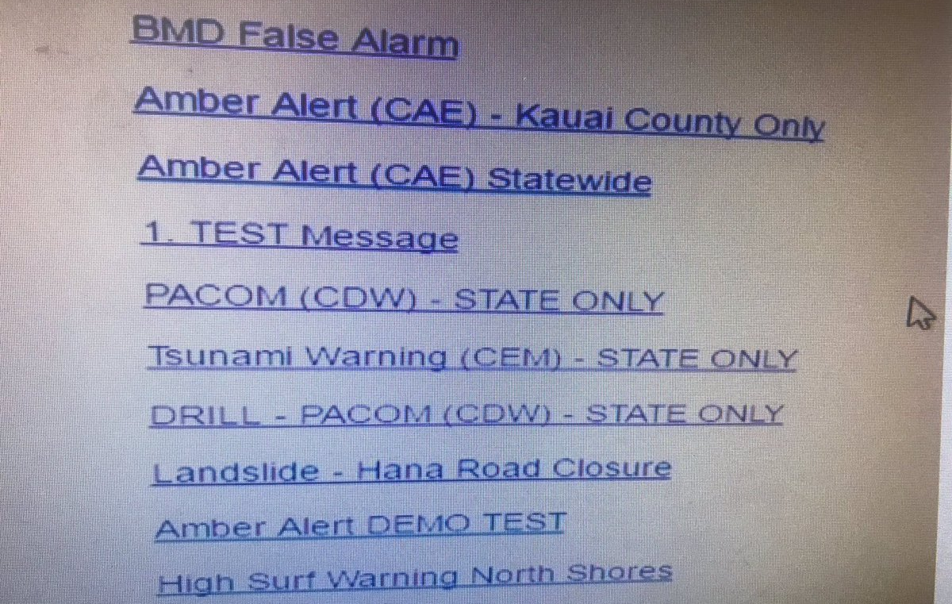
Hawaii Alert System

Slide 51
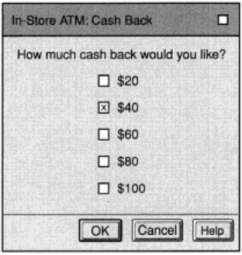
Notes:
blooper-2.17-radio-vs-checkbox
Should be radio buttons instead of checkboxes (since checkboxes imply multiple selections, but this should be just a single selection)

Slide 52
What’s Wrong Here? Kodak Picture Disk software
This one is less obvious
All the items are actions, except for Two Page, which is a toggle. Inconsistent and not the proper use of buttons
Notes:
blooper-2.43-kodak-picture-disk-toggle-vs-command-buttons.png

Slide 53
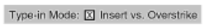
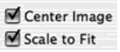
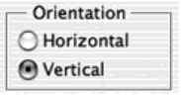
What’s Wrong Here?
Clearer what it is toggling
Or have a set of radio buttons
Type-in Mode: ☒ Insert vs. Overstrike
Notes:
blooper2-2.17-bad-unclear-toggle.png
Can’t tell which mode is which

Slide 54
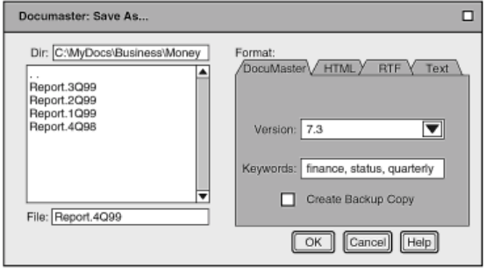
Uses tabs as a selection (weird) vs navigation
Notes:
blooper2-2.26-bad-tabs-used-as-navigation.png

Slide 55
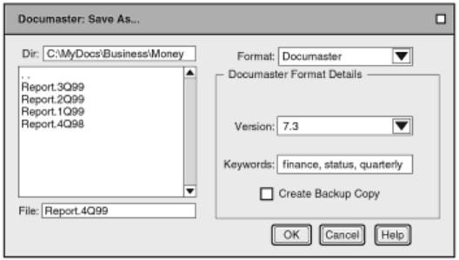
Notes:
blooper2-2.29-good-tabs-used-as-navigation-fixed.png
Here is one way to fix it

Slide 56
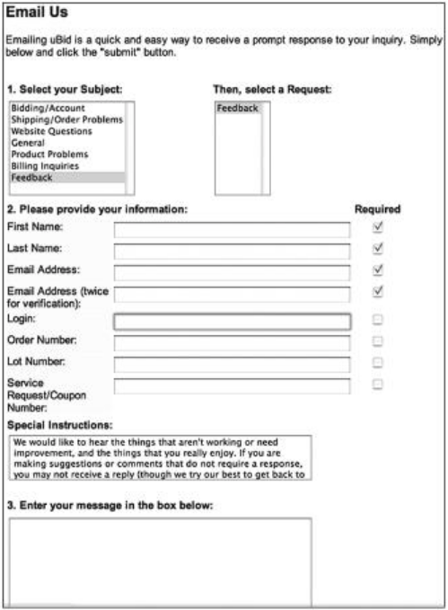
Notes:
blooper2-2.39-bad-incorrect-use-checkboxes.png

Slide 57
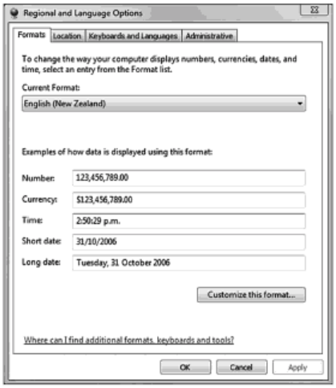
Notes:
blooper2-2.40-uneditable-text-fields.png
Text fields look like you can edit them, but you can’t

Slide 58
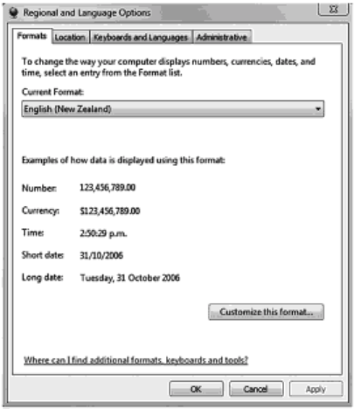
Notes:
blooper2-2.43-fixed-uneditable-text-fields.png
Fixed here, don’t look editable

Slide 59
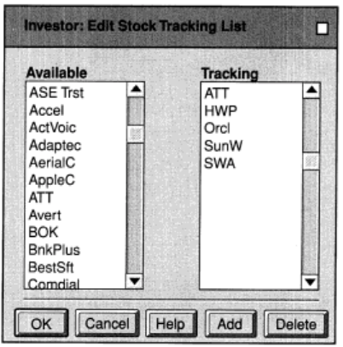
Notes:
blooper-3.1-bad-add-delete-button-wrong-place.png
The Add and Delete are in same row as the other items, doesn’t make good use of spatial layout

Slide 60
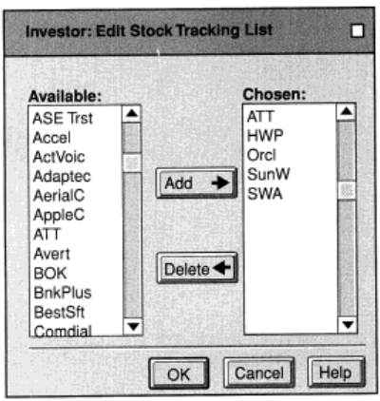

Slide 61
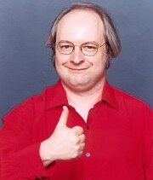
Heuristic Evaluation
Cheap and fast method for finding problems
My personal favorite usability method
Developed by Jakob Nielsen
Basic idea
Review a user interface
Compare each screen against a list of heuristics
See where interface does (or not) comply
Note: which heuristic it violates less important than finding a (potential) usability problem
Recommend using for HW2 ++ before submitting
Will have a HW specifically on practicing HEval

Slide 62
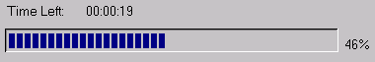
Heuristics H2-1: Visibility of System Status
Keep users informed what is going on
Example: response time
0.1 sec: no special indicators needed
1.0 sec: user tends to lose track of data
10 sec: max. duration if user to stay focused on action
For longer delays, use progress bars
searching database for matches

Slide 63
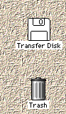



Heuristics H2-2: Match Between System and Real World
Speak the users’ language
Follow conventions
Old example: Mac desktop
Dragging disk to trash
Deletes it or ejects it?
Fixed in Mac OS X

Slide 64

Heuristics H2-2: Match Between System and Real World
Notes:
Also means following convention
Where’s the elevator button? It’s actually in the center island, on the circle, rather than on the wall, like every other elevator in the world
(I think this was in Hong Kong or elsewhere in China, I can’t remember where I took this photo)

Slide 65

Heuristics H2-2: Match Between System and Real World
Notes:
This is an older version of Netflix UI
How to see more Top 10? Not obvious, turns out you mouse over to the right or left side. Doesn’t match any other conventions of web design. Netflix fixed this eventually by showing buttons (see next slide).

Slide 66

Heuristics H2-2: Match Between System and Real World
Notes:
When you mouse over an area, they now show arrows to go left and right

Slide 67

Heuristics H2-3: User Control and Freedom
Make it easy to fix mistakes
Exits for mistakes, undo, redo
Example: Wizards
Good for infrequent tasks (ex. network config)
(Not common tasks)

Slide 68




Heuristics H2-4: Consistency and Standards
Consistent with self?
Consistent with platform standards?
Notes:
For Mac interfaces, usually it’s ok / cancel for left and right. I’ve seen interfaces that reverse these two, very annoying.

Slide 69
Heuristics H2-5 Error Prevention H2-6 Recognition over Recall
Make objects, actions, options, and directions visible or easily retrievable

Slide 70

Heuristics H2-5 Error Prevention H2-6 Recognition over Recall
One way to minimize interference and deal with limited memory
Recall
Reproduced from memory
Recognition
Ex. command in menu reminds you of semantics
Retrieval cues, e.g., icons, labels, menu names, etc.

Slide 71

Heuristics H2-7: Flexibility and efficiency of use
Accelerators for experts
Ex. gestures, keyboard shortcuts
Allow users to tailor frequent actions
Ex. macros

Slide 72

Heuristics H2-8: Aesthetic and Minimalist Design
Elements should be aligned and grouped
No irrelevant information
(Use a grid)

Slide 73


Notes:
Note how the use of a grid for the New York Times helps improve the readability, makes it easier to find info, etc.
Pics from Ed Bott’s web site (though he’s talking about Office ribbon vs layout)
http://www.edbott.com/weblog/2011/08/pull-down-menus-versus-the-ribbon/

Slide 74

Use a Grid to Align Things
Notes:
So one of the most straightforward ways of fixing this problem is by using a grid.

Slide 75
Use a Grid to Align Things
Example Grid – Amazon (1/3)
Notes:
A consistent grid can make it easier to understand a screen, by making things uniform and clean. By being consistent across screens, it can also make it easier to find things.

Slide 76

Example Grid (for print)
Notes:
From Mullet and Sano book. Here is an example of a grid (for print rather than web), but the same basic principles apply.
Note how you can already see the grid based on the instances above.

Slide 77

Example Grid (for print)
Notes:
From Mullet and Sano book
Unfortunately, one big problem with software and web design is that, while a grid is conceptually easy, it can be hard to translate into HTML / CSS. I personally don’t know of good tools or approaches, suggest looking it up to see what you can find.

Slide 78

Heuristics H2-9: Help users recognize, diagnose, and recover from errors
Error messages in plain language
Precisely indicate the problem
Constructively suggest a solution
Notes:
Yes, this is a real error.

Slide 79
Heuristics H2-9: Help users recognize, diagnose, and recover from errors
Notes:
Good example. It highlights prominently that there was an error (contrast and error icon make it easy to see). It also has a link to go to the first error (rather than you having to hunt and find it)

Slide 80
Heuristics H2-9: Help users recognize, diagnose, and recover from errors
Notes:
Good example, see how it flags which survey question to answer

Slide 81
Heuristics H2-10: Help and documentation
Easy to search
Focused on the user’s task
List concrete steps to carry out
Not too long

Slide 82

Notes:
Yeah, I have to use this system. Note that it prominently says “The interface is not always self-explanatory”, not a good sign.

Slide 83
Recap of Heuristics All on One Slide
H2-1: Visibility of system status
H2-2: Match between system & real world
H2-3: User control & freedom
H2-4: Consistency & standards
H2-5: Error prevention
H2-6: Recognition rather than recall
H2-7: Flexibility and efficiency of use
H2-8: Aesthetic and minimalist design
H2-9: Help users recognize, diagnose, and recover from errors
H2-10: Help and documentation

Slide 84
Things you should be able to answer from the readings
Nielsen suggests having 3-5 reviewers
Why not more?
Why not less?
Name at least 4 of the heuristics and give examples
(Harder, not directly in reading) What are some tradeoffs between Heuristic Eval vs User study?

Slide 85
Pragmatic Tips for HEval
When to use HEval?
All the time, all phases of design and implementation
Especially before a user study, no point in letting a user find obvious problems
Can also teach your dev team about Heval
Good bang for buck, they can find + fix problems too
Multiple degrees of depth for Heval
Ex. I look at UIs ~15min and point out likely problems
Ex. I try UI for hour and point out likely problems
Depends on how much time you have

Slide 86
Summary of Today
Slips vs mistakes
Don’t have to have categories of slips memorized
More important is examples of slips
Also know mode errors (common problem)
Designing for errors
Examples of prevention, detection + response
Heuristic evaluation
Fast, cheap usability method
Know most of the heuristics
Know pros and cons of the approach

Slide 87
Example Exam Questions
Name any 3 of Nielsen’s heuristics for Heval
What is the difference between a slip and a mistake? Give an example of each.
Give an example of a mode error
Why does Gates Hillman separate the doors between the ground floor and subground levels? What UX design principle is being applied here?

Slide 88
Action Items
HW2A / HW2B due Wed Sep 12 at 11:59pm
Recommend doing an (internal) heuristic evaluation on your design
Next reading
None
Design of Everyday Things
Get book and start reading it
Reminder: do tutorials on HTML / CSS
Will start class portion in two weeks

Slide 90
Conducting a Heuristic Evaluation
Small set (3-5) of evaluators examine UI
Independently check against heuristics
Evaluators aggregate findings afterward
Can perform on working UI or on sketches
At least two passes for each evaluator
First to get feel for flow and scope of system
Second to focus on specific elements
If system is walk-up-and-use or evaluators are domain experts, no assistance needed
Otherwise might supply evaluators with scenarios

Slide 91

Why Multiple Evaluators?
Every evaluator doesn’t find every problem
Good evaluators find both easy & hard ones
Notes:
http://www.useit.com/papers/heuristic/

Slide 92
Phases of Heuristic Evaluation
1) Pre-evaluation training
Give evaluators needed domain knowledge and information on the scenario
2) Evaluation
Individuals evaluate and then aggregate results
3) Severity rating
Determine how severe each problem is (priority)
Can do this first individually and then as a group
4) Debriefing
Discuss the outcome with design team

Slide 93
Examples of HEval Findings
Can’t copy info from one window to another
violates “Minimize the users’ memory load” (H1-3)
fix: allow copying
Typography uses mix of upper/lower case formats and fonts
violates “Consistency and standards” (H2-4)
slows users down
probably wouldn’t be found by user testing
fix: pick a single format for entire interface
Separate listings for each finding ok

Slide 94
Severity Rating
Estimates of need for more usability efforts
Combination of
Frequency
Impact
Persistence (one time or repeating)
Should be calculated after all h-evals are in
Should be done independently by all judges

Slide 95
Severity Ratings (cont.)
0 - don’t agree that this is a usability problem
1 - cosmetic problem
2 - minor usability problem
3 - major usability problem; important to fix
4 - usability catastrophe; imperative to fix

Slide 96
Debriefing
Conduct with evaluators, observers, and development team members
Discuss general characteristics of UI
Suggest potential improvements to address major usability problems
Dev team rates how hard things are to fix
Make it a brainstorming session
Little criticism until end of session

Slide 97
Severity Ratings Example for Report
1. [H1-4 Consistency] [Severity 3] [Fix 0]
The interface used the string "Save" on the first screen for saving the user's file, but used the string "Write file" on the second screen. Users may be confused by this different terminology for the same function.

Slide 98
HEval vs. User Testing
HEval much faster
1-2 hours each evaluator vs. days-weeks
HEval doesn’t require interpreting user’s actions
User testing is far more accurate (by def.)
Takes into account actual users and tasks
HE may miss problems & find “false positives”
Good to alternate between HE & user testing
Find different problems
Don’t waste participants

Slide 99


Decreasing Returns
Problems found
Cost / benefit
Caveat 1: graphs for a specific example
Caveat 2: scale of interfaces since study
Notes:
Caveat 1: This was just for a single example
Caveat 2: The scale of user interfaces has grown dramatically since this HEval study was done

Slide 100
Results of Using HE
Discount: benefit-cost ratio of 48 [Nielsen94]
cost was $10,500 for benefit of $500,000
value of each problem ~15K (Nielsen & Landauer)
how might we calculate this value?
in-house −productivity; open market −sales
Correlation between severity & finding w/ HE
Single evaluator achieves poor results
only finds 35% of usability problems
5 evaluators find ~ 75% of usability problems
why not more evaluators? 10? 20?
adding evaluators costs more & won’t find more probs

Slide 101
How to Perform Heuristic Evaluation
Why separate listings for each violation?
risk of repeating problematic aspect
may not be possible to fix all problems
Where problems may be found
single location in UI
two or more locations that need to be compared
problem with overall structure of UI
something that is missing
hard w/ paper prototypes so work extra hard on those
note: sometimes features are implied by design docs and just haven’t been “implemented” – relax on those

Slide 102
Designing Warnings
C-HIP Model
See the warning?
Understand it?
Believe it?
Motivated?
Can and will act?
Will talk more about this end of semester
Notes:
Don’t need to know this for midterm, but will for final (we’ll talk about it again when we get to computer security)

Slide 103

Screenshots
Internet Explorer 7 – Passive Warning

Slide 104

Screenshots
Internet Explorer 7 – Active Block

Slide 105

Screenshots
Mozilla Firefox – Active Block

